Slide 1
The State of the Sector
2018 Update
Water and
Wastewater services
in the Danube region
Danube Water Conference
Vienna, May 20-21, 2019

Slide 2
The State of the Sector review
What progress has the region made in providing sustainable (i.e. universal, good quality, efficient and properly funded) services to all and what are the key trends in the sector?
The Austrian Environment Agency in charge of data collection – drawing on public data from many of your institutions – thank you!
More than 25 contributors

Slide 3
State of the Sector
  Environment

Slide 4
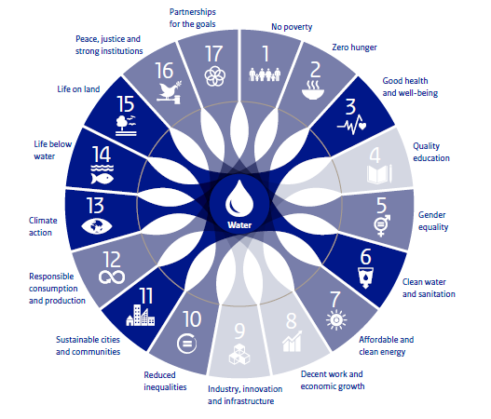
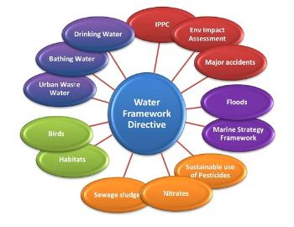

Overall Context?
Notes:
Many small countries
Varying development levels
EU creating significant push for convergence

Slide 5
State of the Sector
  Access

Slide 6
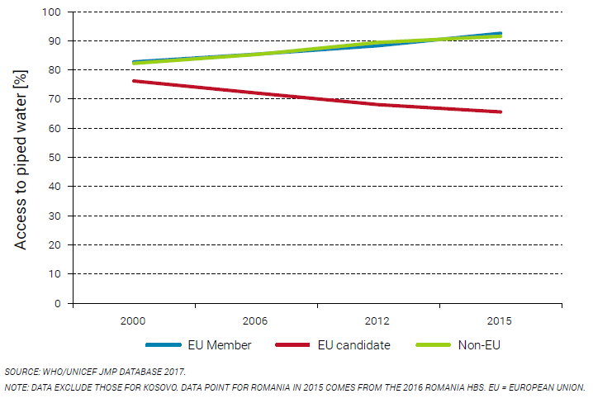
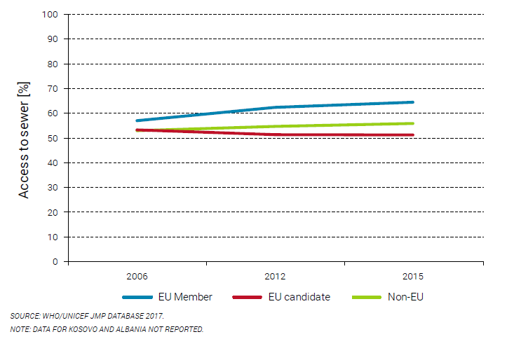
access has improved
But declining trend in non-EU countries
Source: Joint Monitoring Program

Slide 7
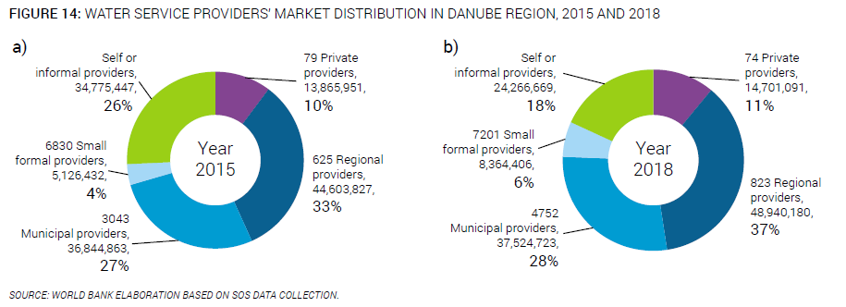
Increased Public
Service Provision

Slide 8
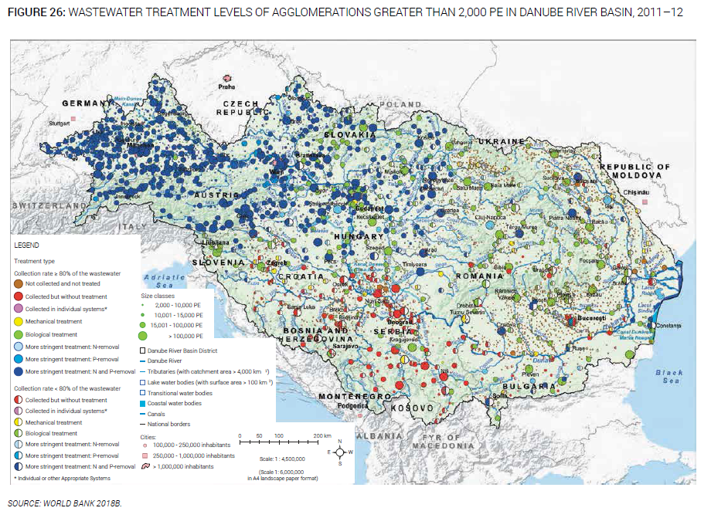
Wastewater Treatment
Meeting the UWWTD a challenge for many countries

Slide 9
State of the Sector
  Performance

Slide 10
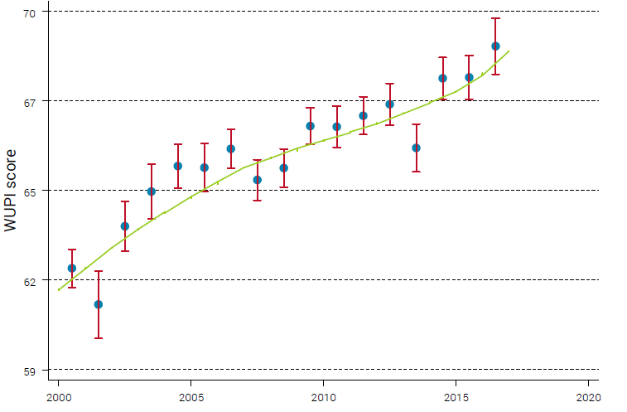
Overall performance
General improvement in performance in the region

Slide 11
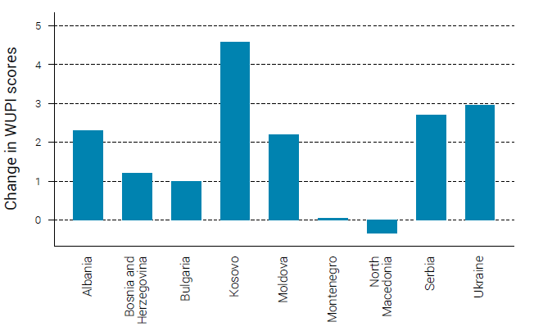
Performance trends
Some countries leaping ahead

Slide 12
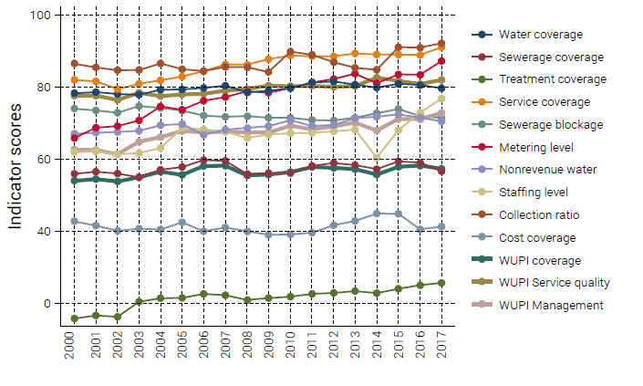
Utility management measures
Indicators for metering, staffing, and collection of tariffs exhibit increased performance

Slide 13
State of the Sector
  Financing

Slide 14
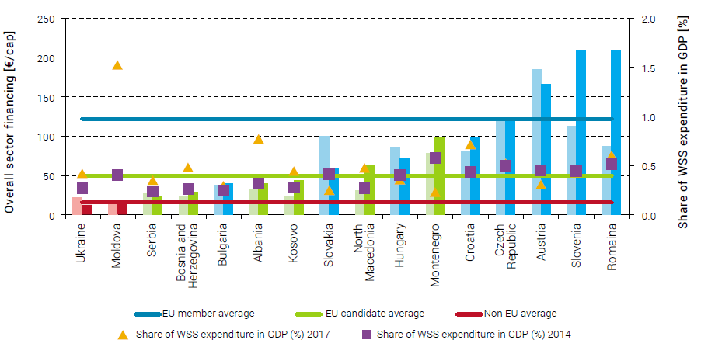
Overall financing
EU members sprinting ahead both in terms of level of expenditure over GDP and sector financing per capita

Slide 15
still a large investment gap

Slide 16
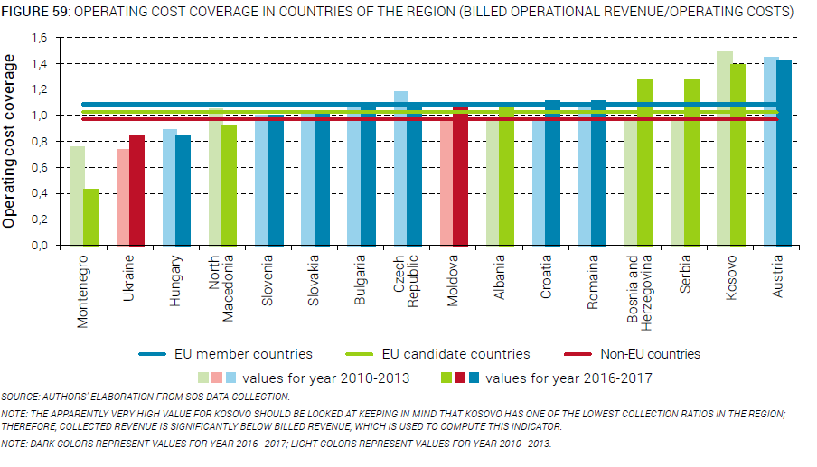
Investment Financing
Operating cost-recovery improved in most countries

Slide 17
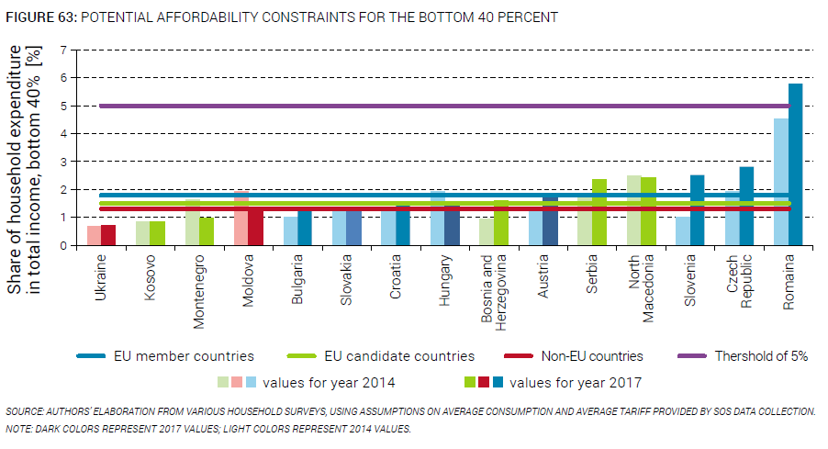
Affordability
An increasing concern

Slide 18
StaTe of the Sector
  Sustainability Assessment

Slide 19
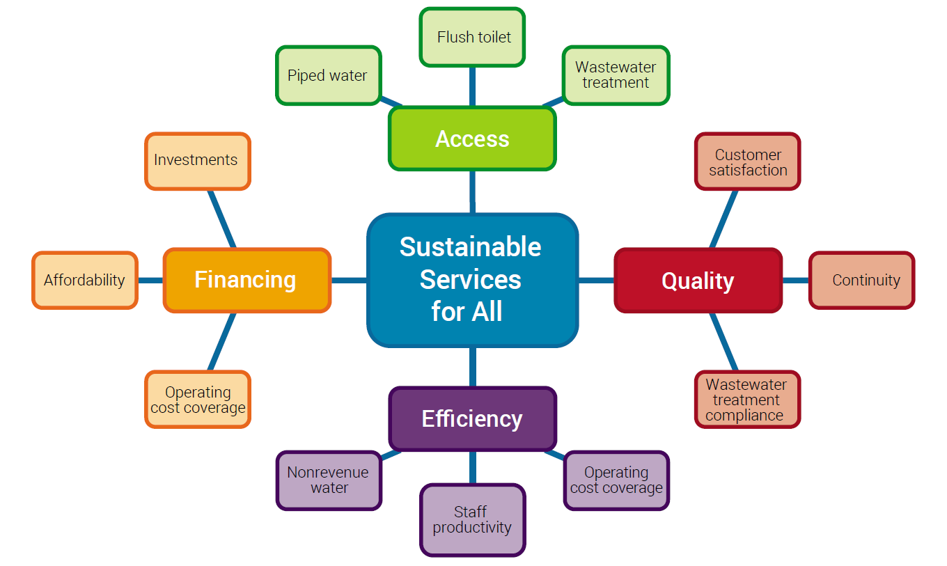
Are services sustainable?

Slide 20
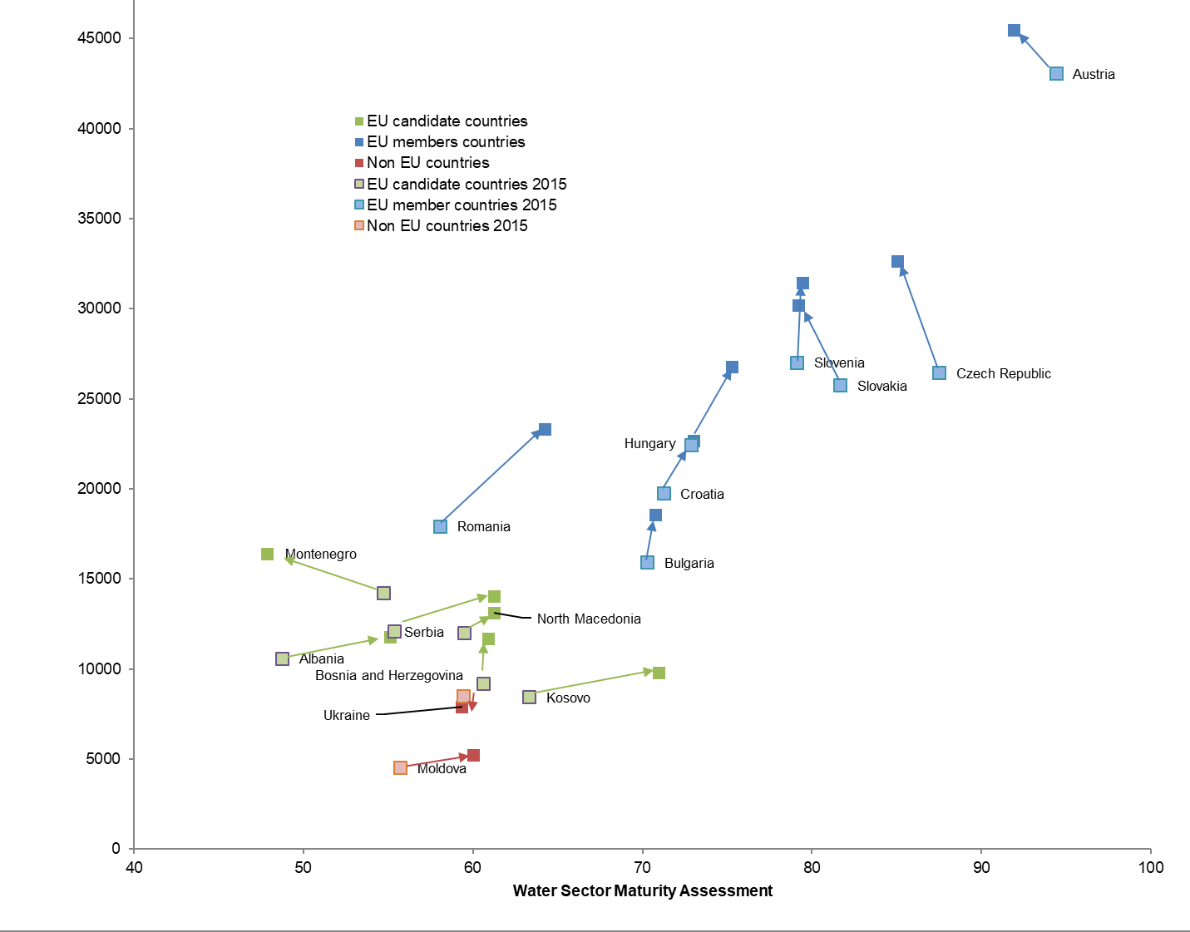
Improvements in most countries

Slide 21
Remaining challenges and policy options

Slide 22
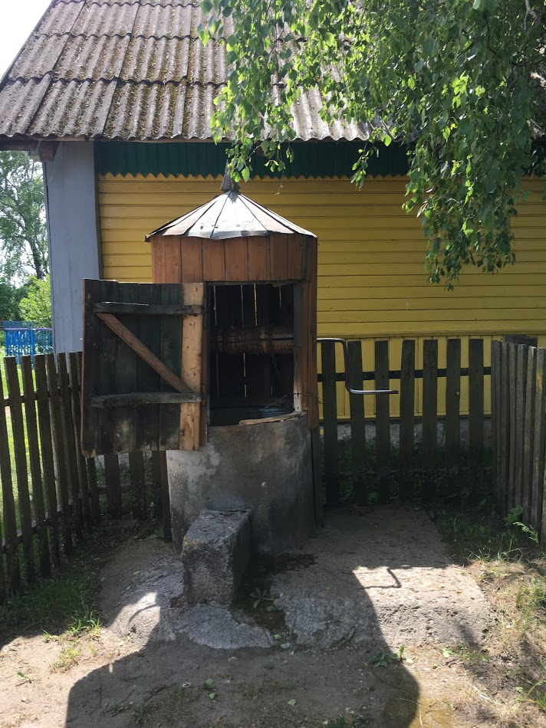
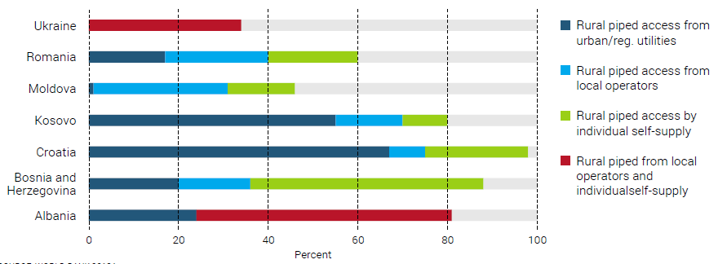
Portfolio Approach for water supply
Rural population still largely relying on local operators and self-supply

Slide 23
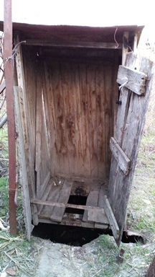
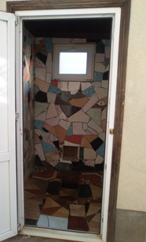
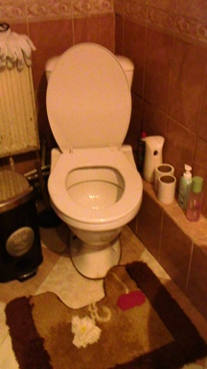
Rural Sanitation
Foster rural sanitation investments, including self-investments and individual solutions

Slide 24
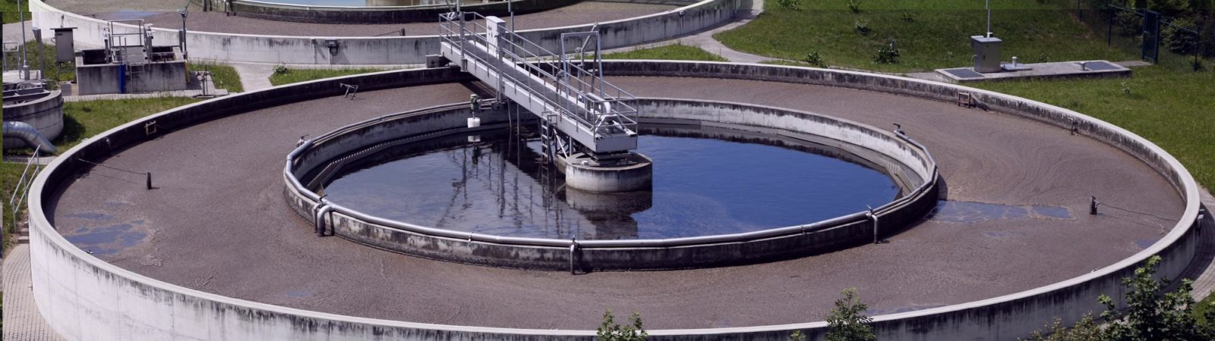
Wastewater Management
New technical, institutional and financing approaches to wastewater management

Slide 25
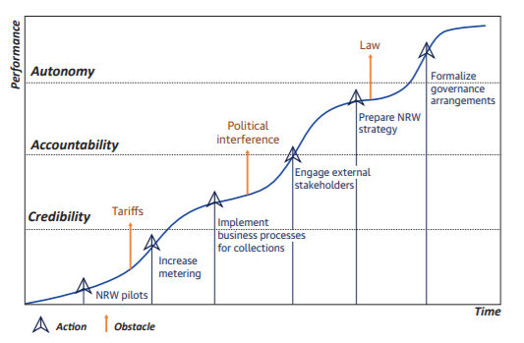
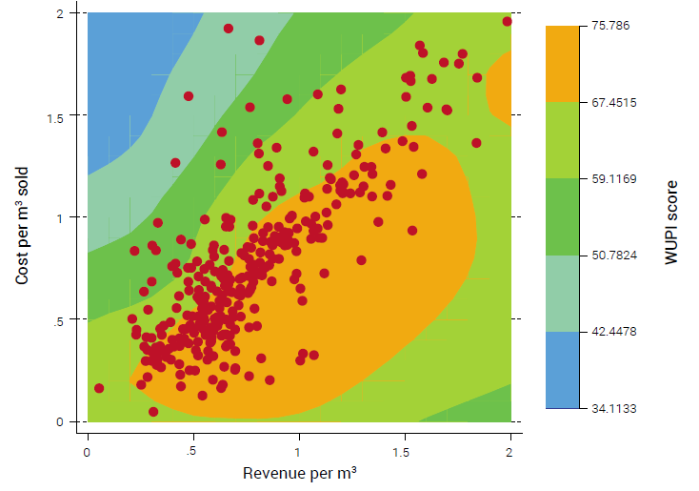
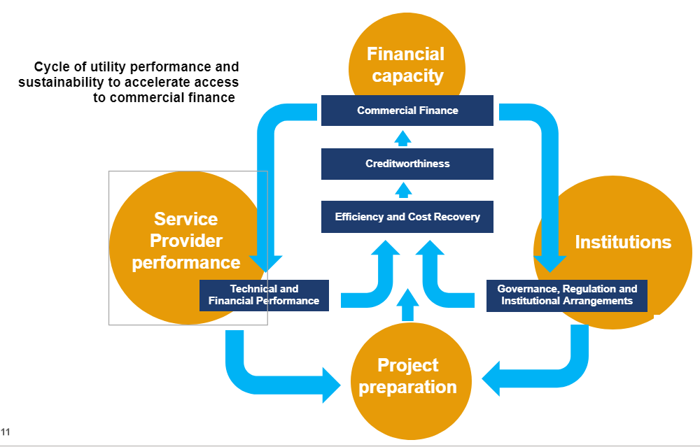
We need to look at financing

Slide 26

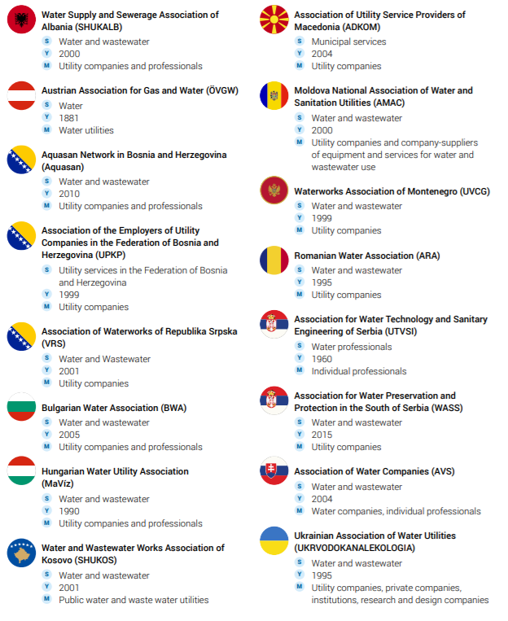


And people and their capacity

Slide 27
Going forward

Slide 28
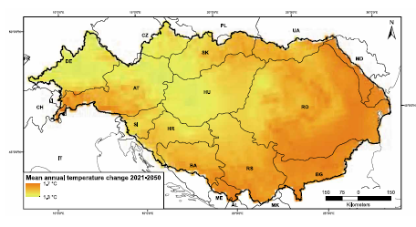
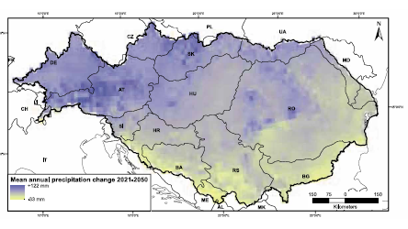
A third challenge is emerging
Global changes
  Economics
  Climate
  Population
  Technologies

Slide 29
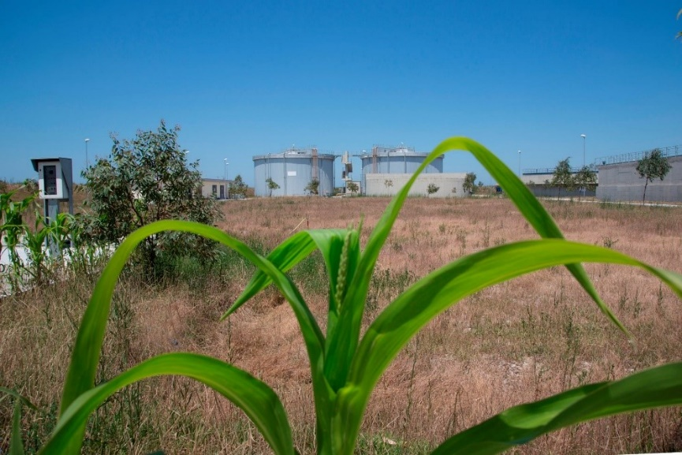

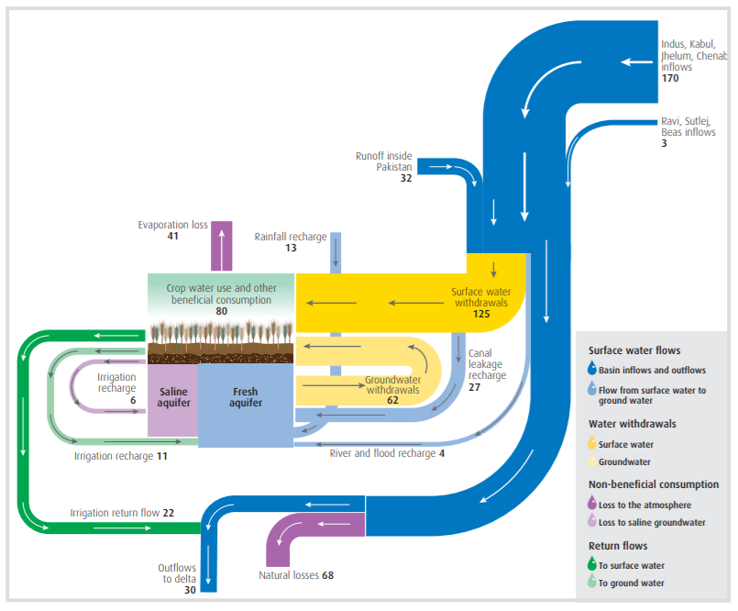
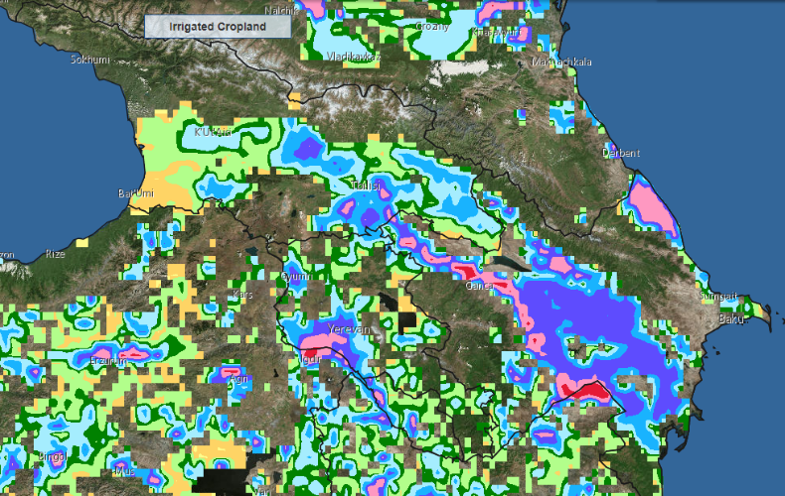
And new solutions are coming
Green and Gray
Circular economy
Big data

Slide 30
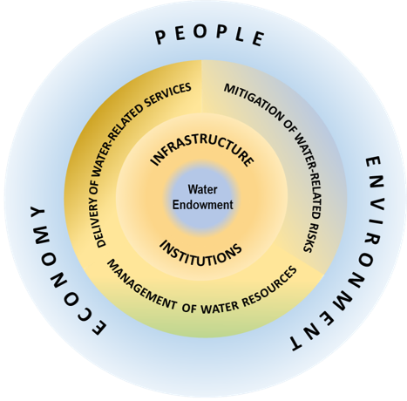
Towards Water security

Slide 31
Thank you
Elvira Broeks
Water and Sanitation Analyst
Water Global Practice
The World Bank
ebroeksmotta@worldbank.org
www.worldbank.org/water
www.danube-water-program.org
www.danubis.org

